Slide 1

Best Practices for Terraform with Vault

Slide 2
Topics
Getting Started Using Terraform
Recommended Architecture
Seeding Vault with Secrets
Consuming Those Secrets

Slide 3




Terraform
Vault
Consul
AWS
Write, plan, and create infrastructure as code.
Manage secrets and protect sensitive data.
Service mesh made easy.
Cloud computing services.

Slide 4
Getting Started Using Terraform
Section 1 of 4

Slide 5
TERMINAL
terraform { backend "s3" {
bucket = "remote-terraform-state-best-practices-demo" encrypt = true
key = "terraform.tfstate" region = "us-east-1"
}
}
$ aws conﬁgure
$ git clone git@github.com:hashicorp/vault-guides.git
$ cd vault-guides/operations/provision-vault/best-practices/terraform-aws/
$ terraform init
$ terraform apply

Slide 6
Recommended Architecture
Section 2 of 4

Slide 7

Single Datacenter
Bastion
Vault
(standby)
Vault
(active)
Vault
(standby)
Consul
Consul
Consul

Slide 8
Workﬂow
One
Terraform spins up Vault backed by Consul.
Three
Terraform pulls secrets from Vault.
Two
Secrets are placed into Vault.

Slide 9

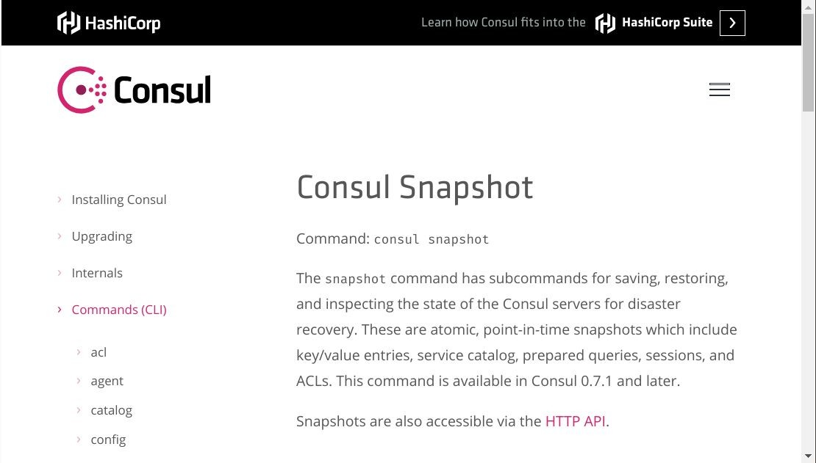

Slide 10
Single Datacenter
Bastion
Vault
(standby)
Vault
(active)
Vault
(standby)
Consul
Consul
Consul

Slide 11
Seeding Vault with Secrets
Section 3 of 4

Slide 12




Every Morning
She Gets a Vault Token

Slide 13

Then She Runs Terraform

Slide 14
Then She Runs Terraform
Terraform State
Username: Very Password: Precious

Slide 15
Then She Runs Terraform

Slide 16
Beneﬁts
Reduces insider threat
Auditability
Nixes credential sharing
You don’t have to commit in your Terraform conﬁg

Slide 17
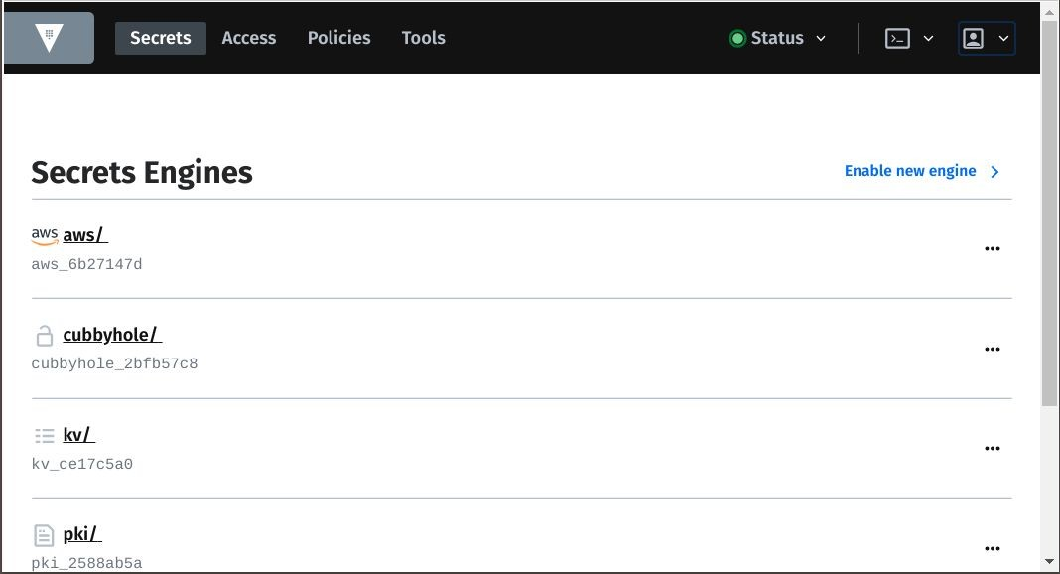


Slide 18
TERMINAL
$ vault policy write dev-policy -<<EOF path "aws/creds/dev-role" { capabilities = ["read"]
} EOF
$ vault auth enable github
$ vault write auth/github/conﬁg organization=hashicorp ttl=86400s
$ vault write auth/github/map/teams/vault value=dev-policy

Slide 19
TERMINAL
$ vault secrets enable aws
$ vault write aws/conﬁg/root \ access_key=$AWS_ACCESS_KEY_ID \ secret_key=$AWS_SECRET_ACCESS_KEY \ region=us-east-1
$ vault write aws/roles/dev-role \ credential_type=iam_user \ policy_document=-<<EOF
{
"Version": "2012-10-17",
"Statement": [
{
"Eﬀect": "Allow",
"Action": "ec2:*",
"Resource": "*"
}
]
} EOF
$ vault write aws/conﬁg/lease lease=5m lease_max=5m

Slide 20
Consuming Those Secrets
Section 4 of 4

Slide 21
TERMINAL
terraform {
required_version = ">= 0.11.8"
}
provider "vault" {
address = "${var.vault_addr}"
}
data "vault_aws_access_credentials" "aws_creds" { backend = "aws"
role = "dev-role"
}
provider "aws" {
access_key = "${data.vault_aws_access_credentials.aws_creds.access_key}" secret_key = "${data.vault_aws_access_credentials.aws_creds.secret_key}" region = "${data.external.region.result["region"]}"
}

Slide 22
TERMINAL
terraform {
required_version = ">= 0.11.8"
}
provider "vault" {
address = "${var.vault_addr}"
}
data "vault_generic_secret" "database" { path = "database/creds/dev-role"
}
provider "some-provider" {
username = "${data.vault_generic_secret.database.data["username"]}" username = "${data.vault_generic_secret.database.data["password"]}"
}

Slide 23
TERMINAL
$ vault login -method=github token=$GITHUB_TOKEN
$ export VAULT_TOKEN=s.dSwQTUmTR30zyEWwPzcxBxu1
$ terraform apply

Slide 24
Summary
One
Terraform spins up Vault backed by Consul.
Three
Terraform pulls secrets from Vault.
Two
Secrets are placed into Vault.

Slide 25


References
Vault Reference Architecture
https://learn.hashicorp.com/vault/operations/ops-reference-archi tecture
Best Practices Vault Cluster on AWS
https://github.com/hashicorp/vault-guides/tree/master/operation s/provision-vault/best-practices/terraform-aws
Production Hardening Guide
https://www.vaultproject.io/guides/operations/production
How to Pull AWS Keys from Vault
https://github.com/rberlind/aws-ec2-instance/tree/from-vault
Copyright © 2019 HashiCorp

